Slide 1
Scottish Teachers for Enhancing Practice (STEP)
Stirling 18th March 2023
Ken Muir
University of the West of Scotland
Independent Advisor to the Scottish Government
https://www.gov.scot/policies/schools/education-reform/
kennethbmuir@hotmail.com @KenBMuir

Slide 2
Reform in context
Putting Learners at the Centre
Drivers for Reform
Reimagining Scottish education
Progress with Reform
Scottish Teachers for Enhancing Practice (STEP)
Stirling 18th March 2023

Slide 3
(Salaries)
Behaviour
Attendance
Assessment + Exams
Accountability
Workload
Survival!
Putting Learners @ Centre
National Discussion
Qualifications Review
Skills Delivery Landscape Review
Education Reform Bill

Slide 4
…. structure, learning practices and assessment approaches in the Senior Phase … need adapting.
…. gap between stakeholders’ involvement and their impact on effective enhancements to CfE implementation
documentation “overwhelming” and terminology used too technical and open to interpretation.
2021
work has become challenging for schools considering the multiple new policy initiatives.
misalignment between Curriculum for Excellence’s aspirations and the qualification system.
absence of an identified cycle of policy review, has resulted in a reactive and oftentimes political approach.
… “a busy system at risk of policy and institutional overload.”

Slide 5
851 Consultation responses
83 stakeholder engagements
1210 Primary children
3889 12-18 year olds
Education reform - gov.scot (www.gov.scot)

Slide 6
Some Views of Children and Young People
“We don’t learn enough about the real world and its problems”
“Goals should be happiness, not exam results”
“It’s the adults that decide what we learn. That’s why it’s not fun”
“It’s not a waste of time but… they do help you learn but they [teachers] don’t help you understand it. They just give you a worksheet”
“We just sit in chairs all day in the classroom, it is boring”
“Teachers do not respect pupils until they reach the senior phase”
“ I have learning disabilities but have had pretty much no support”
“I feel like they [teachers] don’t really listen at all, they just give you
something to do and then you’re on your own”

Slide 8
Some Views of Teachers and HTs
“There needs to be real empowerment for schools to develop rich and aspirational curriculum offers in their own contexts. The investment of time and cash should be in schools not national organisations.”
“A national curriculum agency ie: a body solely focused on this area and rooted in classroom practitioners and senior leaders able to consider the whole picture and untrammelled by political or cultural ideologies.”
“ No one listens to teachers in the development of qualifications.”
“The SQA exams at present have never been fit for purpose within CfE”
“I’m paid to be a leader of learning but am nothing but a leader of admin”
“There needs to be a deep debate and discussion about the future of the curriculum and the purpose of assessment, driven by the needs of young people and of the nation”

Slide 9
Scotland’s Education Ecosystem

Slide 10
Scottish Govt. + Education
Policies
10 Govt. Directorates impact on school education.
Policy fragmented and some lacking coherence.
Policy formulation “Top Down”.
Ministers seen as responsible for Policy + Delivery.
Lack of clear, consensual Vision.
Scottish
Qualifications
Authority
SCQF
Large number of educational “support” bodies.
“Support” not always bespoke to needs.
Resource not always well used + overlap.
Strong “self interest” and protectionism.
Draws best leaders and teachers.
Examinations drive the curriculum + metrics.
Limited “agency”, empowerment and subsidiarity.
“Learner voice” rarely heard in meaningful ways.
Lack of consultation with “experts” on the ground.
Limited/reduced resources, inc. time to share.
Weariness responding to recent challenges.
Education
Scotland inc.
HMI
32 Local Authorities
Skills
Development
Scotland
“Sharp end”
(Local Govt; schools;
practitioners; learners)

Slide 11
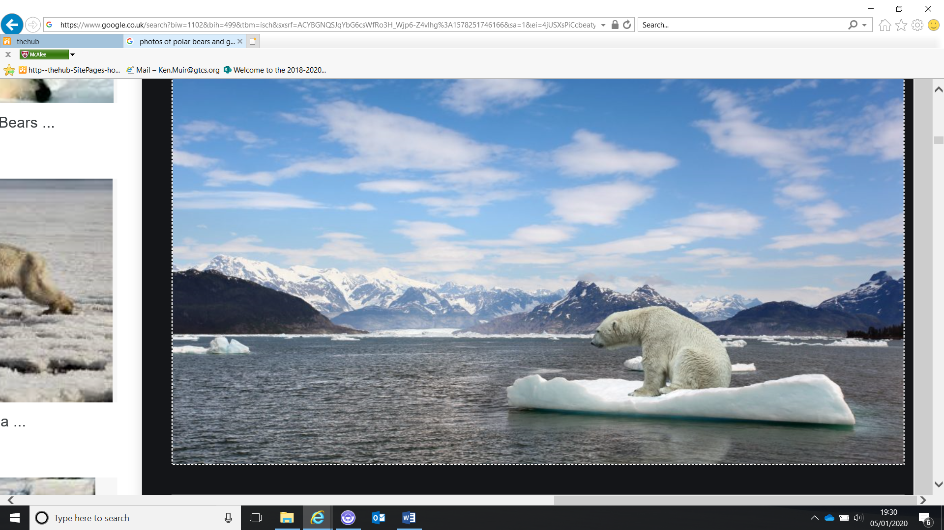
Technological
Change
Student
Change
Climate
Change
Societal
Change
Economic
Change

Slide 13
Future Competences and the Future of Curriculum A Global Reference for Curricula Transformation
Creativity, communication, critical thinking, problem solving, curiosity, metacognition
Digital, technology, and ICTs skills
Basic, media, information, financial, scientific literacies and numeracy
Cross-cultural skills, leadership, global awareness
Initiative, self-direction, perseverance, responsibility, accountability, adaptability
Knowledge of disciplines, STEM mindset.
Future Competencies and Future Curriculum
International Bureau of Education – UNESCO (2019)

Slide 17
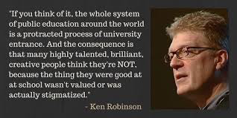

Slide 18
Principles Informing a Re-imagined System
UNCRC Article 29
Excellence and Equity
Place-based, responsive, bespoke support
Early years + outdoor learning
Reduced bureaucracy and appropriate accountability
Diverse society recognition
Increased collaboration
Collation/sharing/use of data
Notes:
, inc. changed met

Slide 19
Principles Informing a Re-imagined System
Climate change driver
Simplification + Coherence in Policy + Support
Focus on learning and teaching
Assessment review + SCQF, inc. different metrics of success
Redistribution of power, influence and resource – a “bottom-up hierarchy”
Resourcing to meet needs
Good governance
Trusting relationships
Notes:
, inc. changed met

Slide 20
Scottish Govt.
+ Education
Policies
Greater integration of Govt. Directorates resulting in less policy and more policy coherence.
Policy informed from “bottom up” expertise.
Reduced politicisation of education.
Ministers retain Strategic Policy responsibility.
Qualifications
Scotland (QS)
New National Agency for Scottish Education – “facilitates” support at local/regional levels.
New Examination + Awarding body (QS) focused on awarding and certification only.
Independent Inspectorate
National Agency accesses “think tanks”+ research.
Increased expert practitioner and learner voice informing policy and change on ongoing basis.
Increased local/regional collaboration for support.
Digital profile to recognise wider achievement?
Redistribution of resource to local levels.
National Agency for
Scottish Education
Local
Authorities
HMI
“Sharp end”
(schools;
practitioners; learners)

Slide 21
Education Reform – Continuous Improvement Context
SHARED ELEMENTS COMMON TO ALL PROGRAMMES
COMMON HIGH LEVEL NARRATIVE ON THE VALUE AND PURPOSE OF LEARNING AND SKILLS DEVELOPMENT THROUGHOUT LIFE (NPF, UNCRC, NSET)
DEVELOPMENT OF SHARED EVIDENCE BASE ON THE VALUE OF LEARNING THROUGHOUT LIFE TO SCOTLAND’S COLLECTIVE WELLBEING
CLEAR ARTICULATION OF WHAT THE CURRENT ECOSYSTEM IS AND WHAT IT DELIVERS (LINKED TO EVIDENCE BASE ABOVE)
NSET SKILLED
WORKFORCE DELIVERY PLAN
National Strategy for Economic Transformation
Published October 2022
NEW BODIES
Implementation of Muir Review Establishment of 3 new Education Bodies
Strategic TOMs 2023
INDEPENDENT REVIEW OF QUALIFICATIONS & ASSESSMENT
Facilitated by Professor Louise Hayward
Reporting
May 2023
PURPOSE
AND
PRINCIPLES
POST SCHOOL EDUCATION, RESEARCH & SKILLS
Spring
2023
Published October 2022
VISION FOR EDUCATION
National Discussion
Outputs in Spring 2023
SKILLS DELIVERY LANDSCAPE REVIEW
Led by James Withers
Reporting
Spring 2023
STRATEGIC CHILDCARE PLAN 2022-26
Strategic Context
DETAILED AND TARGETED CONSULTATION, DISCUSSION AND CO-DEVELOPMENT ACROSS RELATED STRANDS OF ACTIVITY - MAY 2022 – MAY 2023
Notes:
Education reform is a broad and transformational suite of packages to deliver real change across the whole landscape of Scottish education.
Slide illustrates where these reform packages and approaches are situated alongside wider reform agenda across our education and lifelong skills systems. Clearly lots of dependencies in and out. Cross portfolio / government assurance and information exchange processes being put in place to manage implications across and for system wide change.
The need to review and reform these system-level interactions was a core theme of Professor Muir’s report and one we will take forward including ensuring that the new bodies support and enhance the outcomes of the post-school education work being taken forward across Scottish Government.
Example - design of the new national education bodies and the Education Reform Bill which will underpin this process will reflect the outputs and recommendations of these critical pieces of work, along with wider contexts such as Early Learning and Childcare policy activity, the development of Purpose and Principles of post-school education, research, and skills and the review of the skills development system.
Strategic Childcare Plan 2022-26: The Plan sets out how we will embed the benefits of our transformational investment in 1140 hours of high quality funded Early Learning and Childcare. It also explains our approach to expanding our childcare offer over the next four years, including building a future system of school age childcare and a new early learning and childcare offer for one and two year olds, starting with those who need it most.
Strategic plans and priorities
The policy and delivery response across our country needs to be cross portfolio and cross sectoral; and to be truly transformative. For example, Scotland’s National Strategy for Economic Transformation, published in March 2022, seeks to respond to this context, and sets out an ambitious but delivery focused approach to transforming Scotland’s economy over the next ten years.
National Discussion - facilitated by Prof Carol Campbell and Prof Alma Harris
Establish a compelling and consensual 20 year vision for Scottish education.
Be inclusive of all interests with a focus on those we don’t normally hear from.
Seek to build on achievements to ensure the system adapts for the future.
The vision which is created will drive decision making across the system and bring together our ambitious programme of reform.
Independent Review of Qualifications and Assessment – led by Prof Louise Hayward
The focus of this work is school and college qualifications accessible in the senior phase.
Review has been designed to ensure that all those who have an interest in the future of qualifications an Awards have opportunities to be part of the review.
View of business is crucial and discussion being led by the CBI.
New Public Bodies
The establishment of three national education bodies and the Education Reform Bill will reflect the process, outputs, and recommendations of all areas of Education Reform including the National Discussion and the Independent Review of Qualifications and Assessment.
Real change and meaningful reform is not something that government can or should do alone. That is why we launched a National Discussion on Education, a core recommendation of Professor Muir’s report, to involve everyone in the creation of an education system ready for the future.
The timing and sequencing of the Independent Review of Qualifications and Assessment and the development of the new national education bodies will allow them to reflect the outcome of the National Discussion, making sure the voices and views that come through the discussion guide our wider reform activity.
The National Discussion will run until early December with outputs in early Spring. The Independent Review of Qualifications and Assessment will be able to take account of these when it completes its work and makes its recommendations.
Design of the new national education bodies, and the Education Reform Bill, will reflect the outputs and recommendations of these critical pieces of work. It will also draw on other areas of reform, including Early Learning and Childcare, post-school education, research, and skills and the independent review of the skills delivery landscape.
A key part of the Education Reform programme and the specific work to establish the new national bodies will cover what the landscape of roles and responsibilities does, could and should look like in a reformed system. In this context, we recognise that the new bodies will deliver critical work in of themselves but must also add value via how they engage with the wider system.
Independent Review of Skills Delivery – led by James Withers
How the skills delivery public body and advisory landscape can be adapted to drive forward the objectives and outcomes of the National Strategy for Economic Transformation (NSET) and the Scottish Government’s response to the Scottish Funding Council (SFC) Review of Coherence and Sustainability.
The future functions, remit and status of Skills Development Scotland within the wider delivery landscape.
Post School Education, Research and Skills
As part of our broad reform agenda, it is imperative that we have a post school education, research and skills ecosystem that delivers for all people.
Scottish Government are therefore working to define the ‘Purpose and Principles’ for the post school education, research and skills ecosystem. This presents a bold and exciting opportunity to galvanise all actors across the system behind a shared purpose, articulating clearly defined roles and responsibilities and providing a clear strategic framework for decision-making based on the outcomes we want to see. This will help us to shift cultural expectations and challenge perceptions of what the system can deliver.

Slide 22
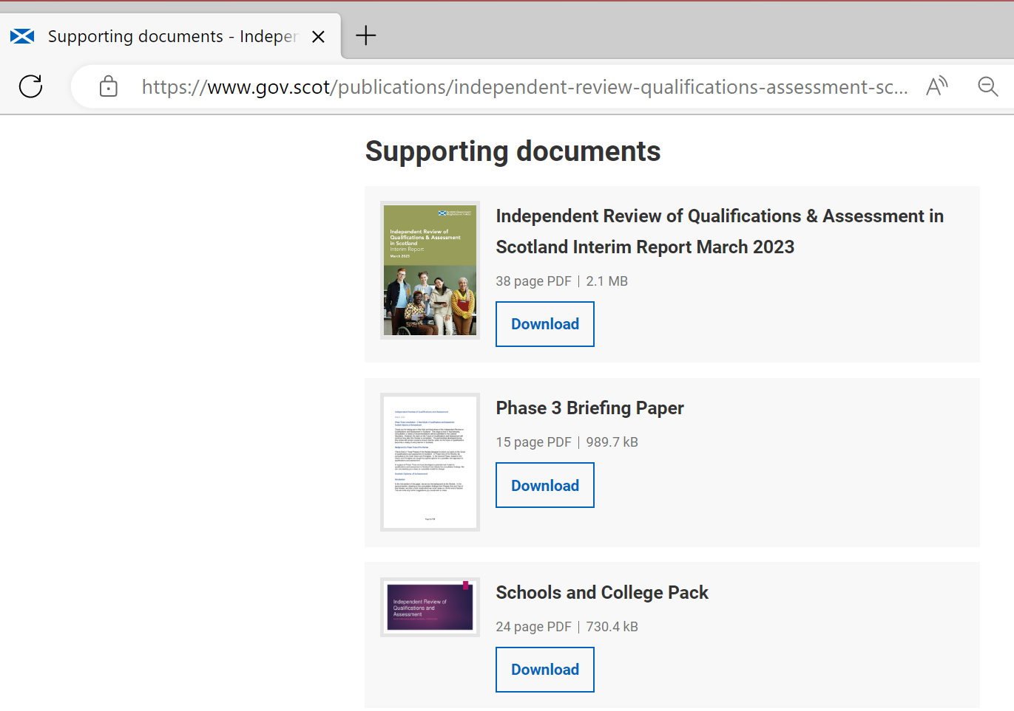

Slide 23
Areas of general consensus about the Future of Qualifications and Assessment in Scotland
There is a need for change
The progression and achievements of individual learners, beyond exam results, should be valued and recognised
The metrics of success need to be broader than exam results
“NO” to 3 consecutive years of high stakes examinations
Better balance needed between internal and external assessment
A wider range of assessment approaches should be introduced
The learner should be at the centre of every decision taken

Slide 24
IRG = Independent Review Group
CCG = Collaborative Community Group
Phase 3 = consultation through CCGs, allied discussion groups, via schools and colleges and a range of other meetings (March 2023)

Slide 26
Draft Qualifications and Assessment Model
A broadening of the evidence collected during the senior phase to include skills and other competencies
Significant reduction in external assessment, including examinations, across the senior phase
A better and more clearly defined integration of academic and vocational qualifications
The development of enhanced digital infrastructure that will enable the use of digital assessments and will also support learners to gather and present their achievements consistently no matter the educational setting within which they are based

Slide 27
New National Agency
The main focus of the proposed national agency for Scottish education should be to provide responsive, bespoke support and professional learning at regional and local levels. In addition, the agency should advise the Scottish Government on curriculum and assessment policy.
The proposed national agency for Scottish education should create and sustain a forum for ongoing and proactive discussion about curriculum, assessment, learning and teaching, professional learning and leadership in Scotland. It should gather views from national bodies, existing think tanks, research and practices, including in other jurisdictions, in order to develop and enhance key policies.

Slide 28
New Qualifications and Assessment body
“the governance structure of the proposed Qualifications Scotland body should be revised to include more representation from, and accountability to all learners, teachers, practitioners and the stakeholders with whom it engages.”
Strengthen the role of learners’ and teachers’ voices in the governance and advice to the body on the exercise of its functions from the perspectives of learners, teachers and practitioners
Clearer requirements on the Qualification Body’s planning and reporting in relation to its performance, and the effectiveness of its communications and engagement with learners and all other stakeholders
Need to continually innovate the quals and assessment services, and respond to present or future changes in the quals and assessment system
Accreditation and Regulation to be demonstrably needs to be more independent from Awarding

Slide 29
Independent Inspectorate
The Bill will seek to establish a new independent inspectorate [that will be] “be responsible for the inspection of education at all levels of the system – from early years to adult learning, including thematic inspections required by Ministers, for example in Initial Teacher Education”
HMCI - power to set the schedule, frequency and focus for inspections
Increased learner and service user input in governance and inspection
Annual and longer-term “trend” reporting to Scottish Parliament
Statutory functions, eg registration + regulation of independent schools and thematic reviews of ITE, to remain

Slide 30
Questions in re-imagining education
To what extent are our schools and curriculum preparing current and future learners for the world which they will encounter and in which they need to survive and thrive?
How best do we ensure that student and teacher voice and agency are deliberately activated as a natural by-product of the culture built in the school and the system as a whole? What other aspects of culture and mindset need to change?
What opportunities does the curriculum offer for learners to develop global competencies?
What metrics should be used to determine success?
What should learning and our education system look like if we are to live lives that have meaning for the individual and significance in the world, and to work together to solve our greatest problems?
What purposes do learning + education systems need to serve if humanity and our planet are to flourish?
What can STEP offer in addressing these questions?

Slide 31
Scottish Teachers for Enhancing Practice (STEP)
Stirling 18th March 2023
Ken Muir
University of the West of Scotland
Independent Advisor to the Scottish Government
https://www.gov.scot/policies/schools/education-reform/
kennethbmuir@hotmail.com @KenBMuir

