Slide 1

Improving Classroom Communication
Jamie Thom
@teachgratitude1

Slide 2

Inspiration

Slide 3

Drainspiration

Slide 4
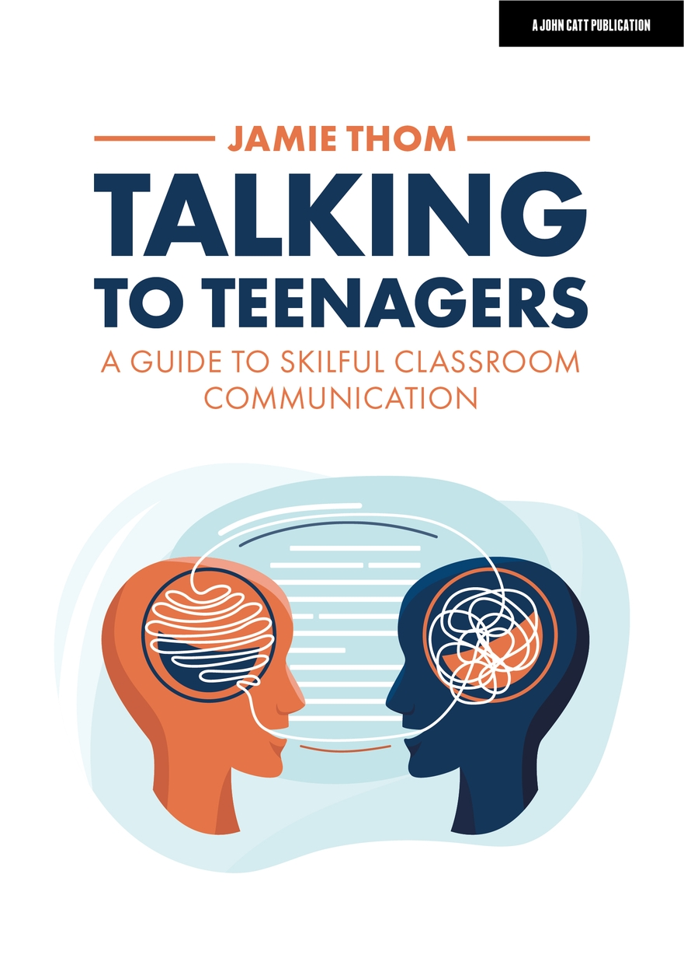

Slide 5
1. Understand the complexity of the teenage audience
2. Master the non-verbal
3. Script and teach behaviour
4. LEAP into dialogue
5. Drive motivation, build habits.

Slide 6

1. Understand the complexity of the teenage audience

Slide 7
Teenage Feedback
“When you begin to realise that you are growing up and maturing, when you notice that the world around you soon won’t just let someone hold your hand through everything that you do. Without knowing, without truly understanding the world, we are about to be shoved into it. That‘s terrifying!”
The overarching feeling of dread that looms over one’s head. Where will I be in the future? When will I die? What if I don't make it? What is everything, why is everything? Just, what?

Slide 8


The Teenage Brain

Slide 9
Four Key Teenage Brain Points
1. The pre-frontal cortex (rational part of the brain) is still developing
2. Teenagers are much more driven by their amygdala, the emotion centred part of the brain
3. Synaptic pruning. Unused connections are ‘pruned away’. Impact on self-regulation, attention, emotional regulation.
4. Excessive serotonin and cortisol – irrational behaviour. Dopamine – reward behaviour.

Slide 10
What are the implications in your classroom?
Have empathy and compassion
Celebrate the good (unconditional positive regard)
Model consistency and calm
Lower cognitive load
Management of behaviour that is detached and clear.

Slide 11
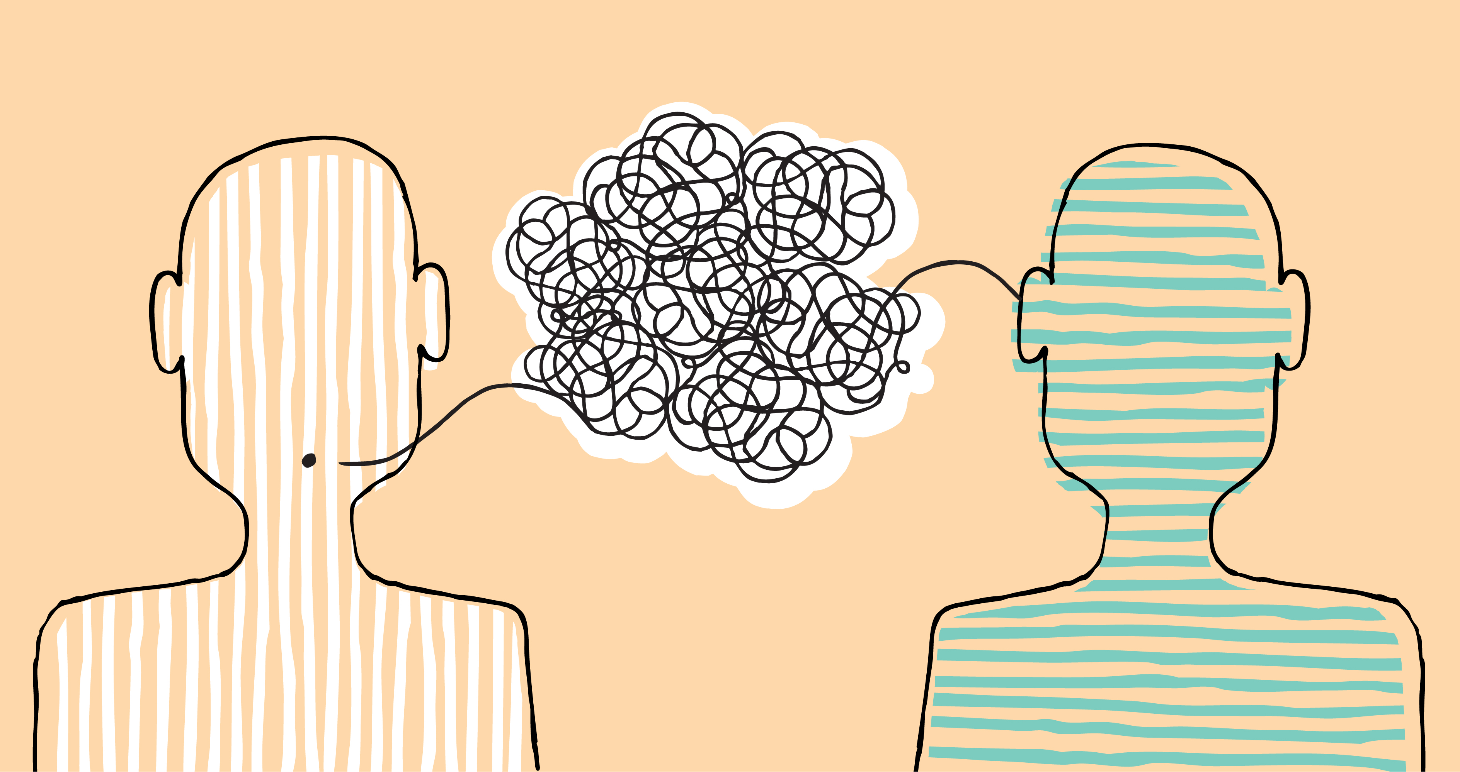
Your Communication

Slide 12

2. LEAP into dialogue

Slide 13
Teenage Feedback
“Always make sure to explain as if trying to talk to a rather well-educated bird. Please do not talk down to those asking for clarification. Despite some students not trying to pay attention initially, that does not mean *all* students in need of a re-explanation or further clarification are inherently evil little goblins trying to destroy the lesson structure. It’s normal to need exposition. There’s a whole song about it.”

Slide 14

Listening
“The quality of your attention determines the quality of other people's thinking.”

Slide 15

How to Improve Listening
Model quality listening
Explore the WHY
Shut out distractions
Focus on how you talk.
Chart and scaffold listening.

Slide 16

Explanations

Slide 17

How to Improve Explanations
1. Be conscious of the curse of knowledge
2. Break down the explanation
3. Keep out of the weeds of the explanation
4. Evoke curiosity
5. Frame it as a story

Slide 18


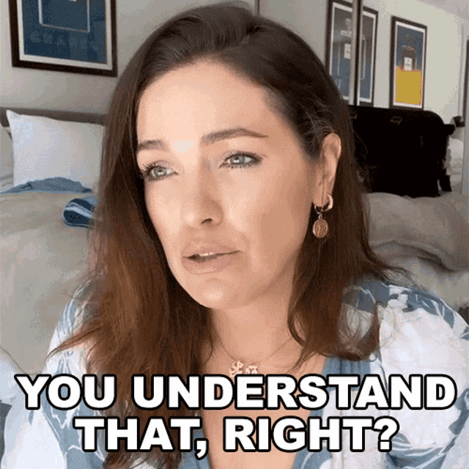

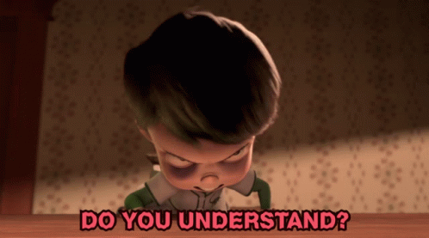
Check for Understanding

Slide 19

Move from Check to Analyse
Sensitive Cold Call
Mini-whiteboards – summarise what you have learnt.
Switch to “what do you understand?”
Use paired discussions – explain it to your partner.
Seek feedback – what did you find helpful?

Slide 20

Independent Practise
Builds self-efficacy and motivation
Prioritise time
Set meaningful goals
Sacred silence (don’t over-narrate)
Circulate with intent

Slide 21

Tips to Improve your Communication
Do a communication self-audit
Slowly focus on one area.
Seek feedback – student and teachers.
Record yourself
Practise

Slide 22




Thank you
Contact me on Twitter at @teachgratitude1
Podcast: Beyond Survival: The New Teacher Podcast

